Slide 1
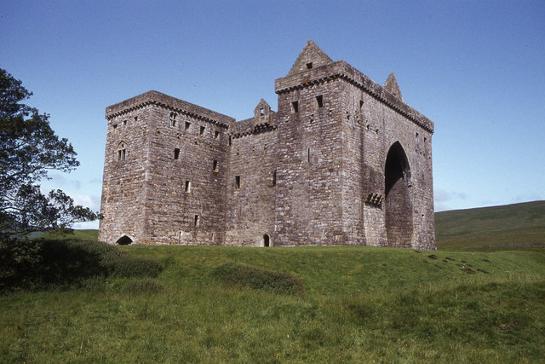
Visiting Scotland in 2023
This Photo by Unknown Author is licensed under CC BY-SA

Slide 2
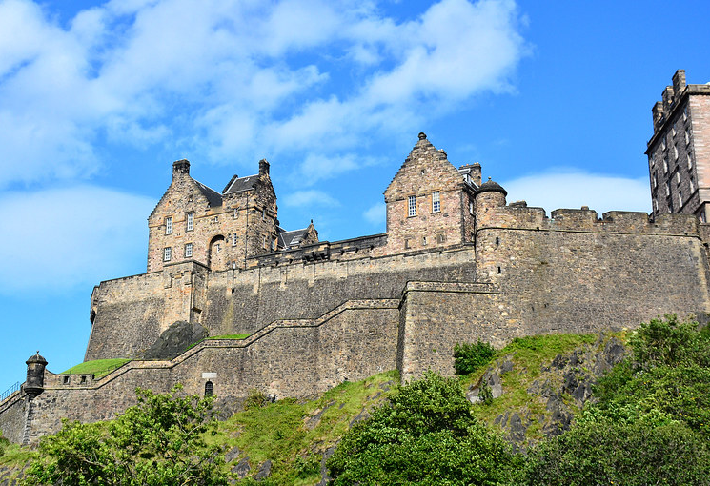
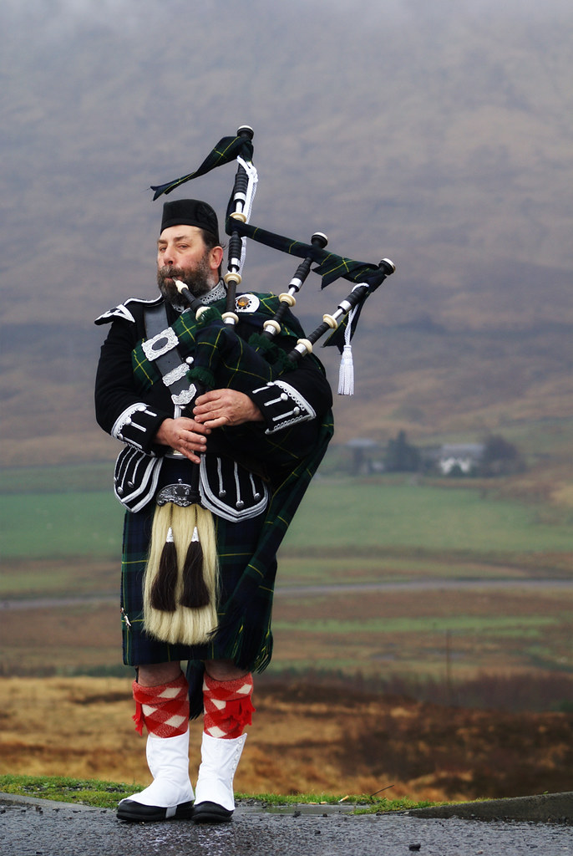
Visiting Scotland: Pros
Scotland is OPEN for Tourism!
Hotels, Restaurants & Attractions are now open
Some with reduced staff, hours & availability

Slide 3
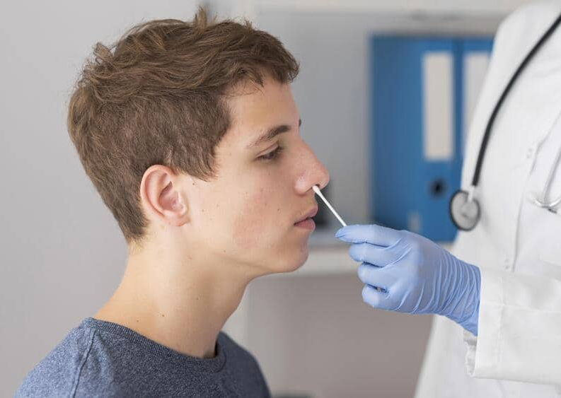
Visiting Scotland: Pros
No Covid requirements
No vaccination
No entry pre-testing requirements
No Passenger Location Form
No Isolation on arrival
No pre-testing required on return to US or Canada

Slide 4
Visiting Scotland: Pros
Scotland is OPEN!
No Covid requirements
No vaccination
No pre-testing requirements
No Passenger Location Form
No Isolation on arrival
£ is down
$1.35 in 2019
$1.15 in 2022

Slide 5
Visiting Scotland: Cons
INFLATION!
Prices UP 18 – 25 % from 2019
Petrol (Gas/Diesel)
Hotels
Food

Slide 6
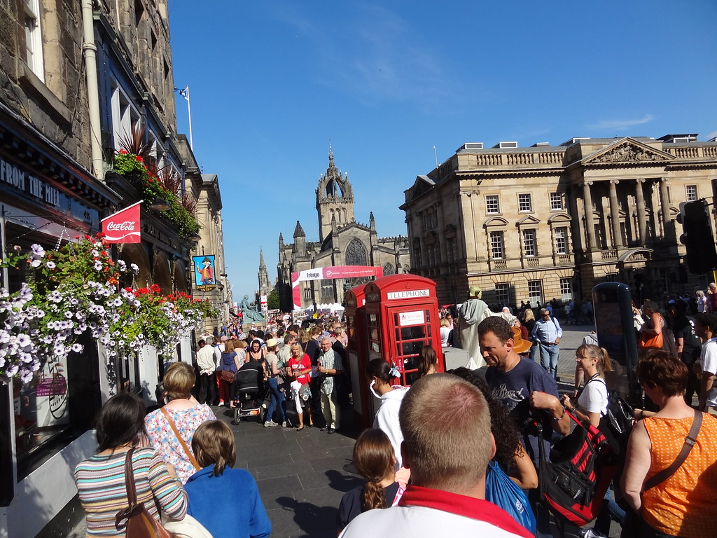
Visiting Scotland: Cons
EXPENSIVE IN AUGUST
Traditional Holiday Period in Europe
Edinburgh Fringe Festival
Hotel Rooms will double in price
Hotel rooms are hard to find anywhere in Scotland

Slide 7
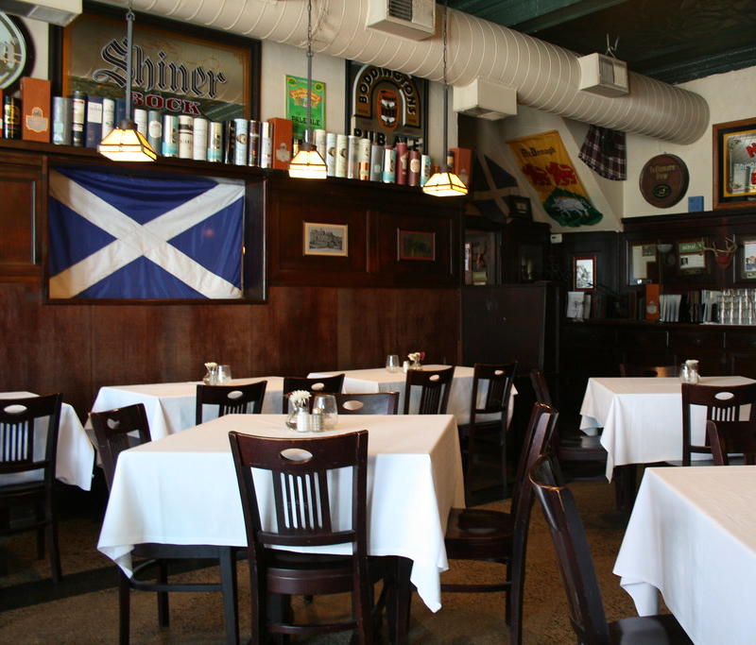
Visiting Scotland: Cons
REDUCED Staff, Hours, and Availability
Fewer guest workers due to BREXIT
Fewer Hotel rooms
Fewer Restaurant servers
Reduced operating hours for attractions
This Photo by Unknown Author is licensed under CC BY

Slide 8
Travel Documentation
Passport
Valid for Whole Length of Stay
+ 6 months is better
Visa:
NOT required for Americans and Canadians

Slide 9
Covid Travel Requirements
NOT REQUIRED!
Vaccination
Pre-Arrival Testing
Isolation on Arrival
Passenger Location Form
Pre-Testing to return to the USA or Canada

Slide 10
Covid Travel Requirements
Useful Websites
https://travel.state.gov
https://travel.gc.ca/travel-covid
https://www.gov.uk/uk-border-control

Slide 11
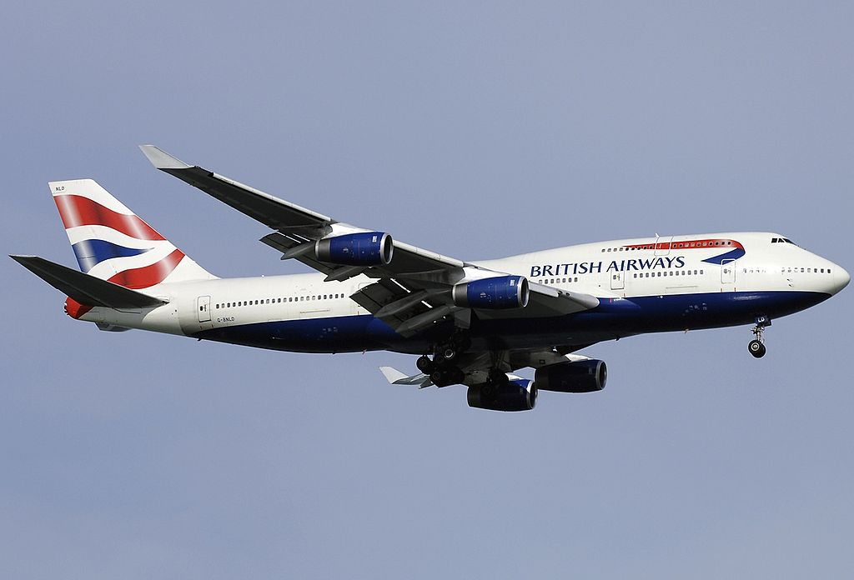
GETTING THERE
Cruise Ship
Takes about a week
Docks in Southhampton
Airplane
About 7 hours from East Coast
This Photo by Unknown Author is licensed under CC BY-SA

Slide 12
Flying to Edinburgh
Airport Direct Flight One-Stop
JFK $1400 $900
Newark $1000 $900
Philadephia NA $1000
Washington Dulles $800 $850
Travel Light!
Increased Lost Luggage due to poorly trained handlers

Slide 13
Accommodations
Limited Options
Few hotels, mostly small
Scattered B&Bs
Newcastleton
Grapes Hotel & Liddesdale Hotel
5 rooms each
9-10 B&Bs
RESERVE NOW!!!

Slide 14
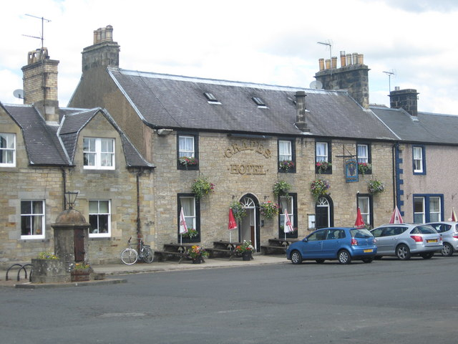
Accommodations
Carlisle 25 miles 50 minutes
Gretna Green 20 miles 40 minutes
Langholm 10 miles 25 minutes
Hawick 21 miles 45 minutes
Lockerbie 31 miles 50 minutes
Dumfries 42 miles 80 minutes
RESERVE NOW!!!

Slide 15
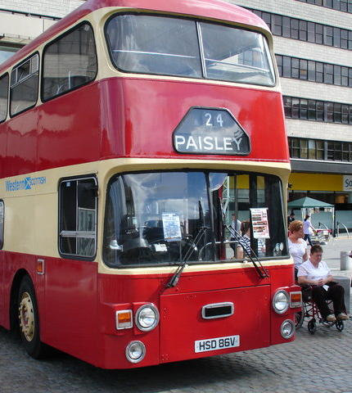
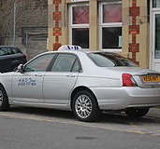
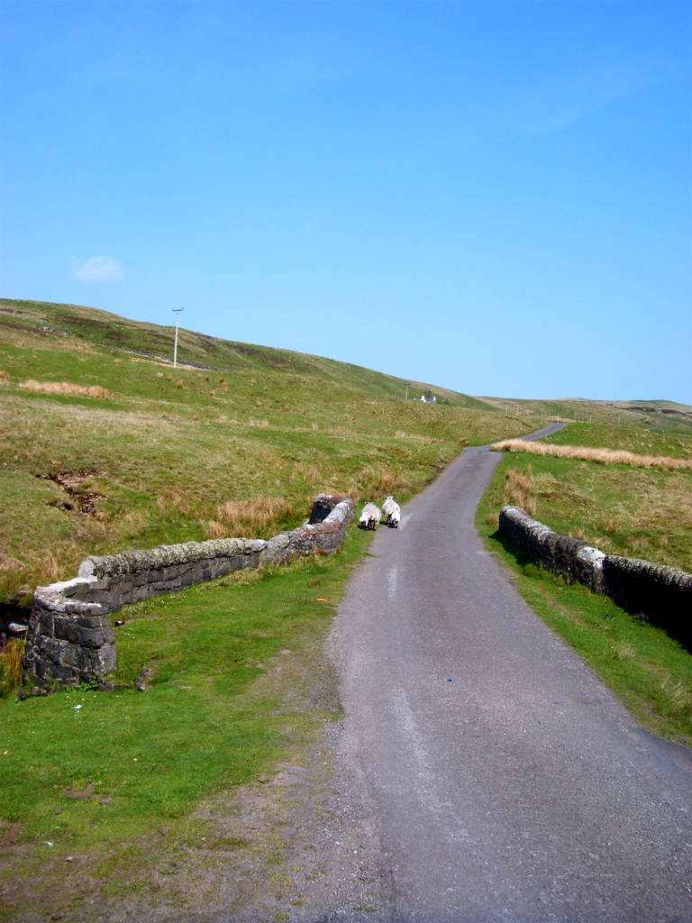
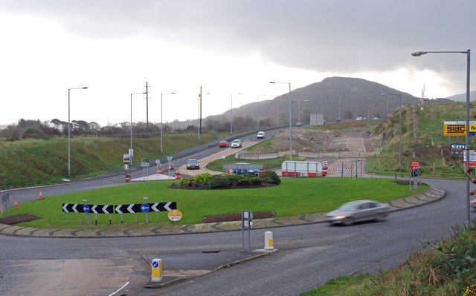
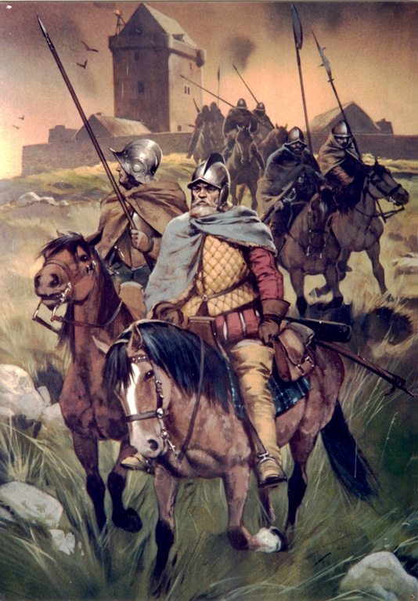
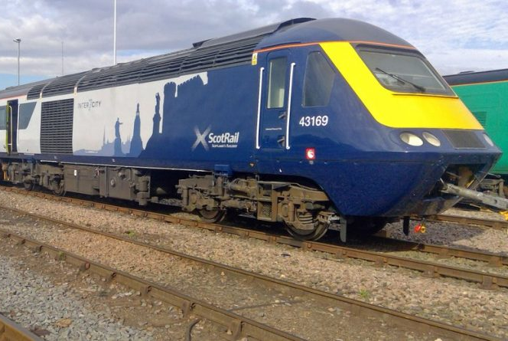
Getting Around in the Borders

Slide 16
Getting Around by Train
Edinburgh Waverley Station – Galashiels
1 – 1 ½ hours
40 miles more to Newcastleton
Edinburgh Waverley Station – Carlisle
1 ½ - 2 ½ hours
25 miles more to Newcastleton
Price
Day of week
Time of day
Class of seat

Slide 17
Getting Around by Bus or Taxi
Hawick – Newcastleton
1 – 2 hours
Departs 8am, 11am, and 12.30pm
Returns at 10am
Carlisle – Newcastleton
1 – 1 ½ hours
Departs 8am, 11am, and 2pm
Returns at 1pm and 4pm
Taxi from Hawick or Carlisle
£70 - £100 ($80 - $115) one way

Slide 18
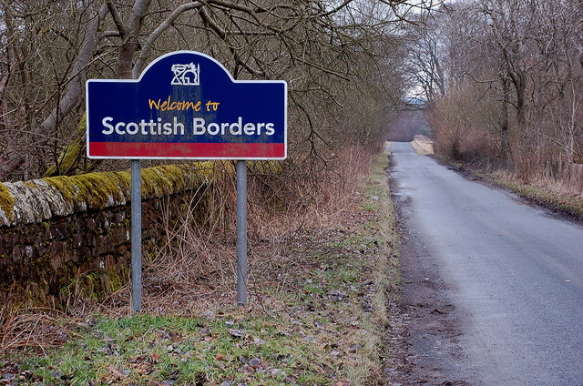
Getting Around by Car
This Photo by Unknown Author is licensed under CC BY-SA

Slide 19
GETTING AROUND BY CAR
Rental Car (Self-Drive)
Edinburgh Airport rental agencies
Alamo EuropCar
Enterprise
Avis Arnold Clark
Budget SixT
Hertz
National

Slide 20
Getting Around by Car
Approximate Prices
Per Day Per Week
Sedan $100 $350 - $500
Estate/SUV $200 $550
Minivan (MPV) $300 - $400 $1000
Extra
Automatic Shift
GPS (SAT-NAV)
Child Seat
All inclusive Insurance

Slide 21
Getting Around by Car Safely
Left Hand Drive
Totally different perspective
Drive a few minutes around the parking lot or residential area
Passenger acts as second pair of eyes
Helpful when turning, changing lanes or in roundabouts
Automatic drive is recommended – one less thing to worry about
Roads can be very narrow – keep eye out for traffic and use pull bys
Most cars use DIESEL – runs about $10/gallon at present
All-inclusive insurance is highly recommended
US insurance rarely accepted
Dings & Scratches
Roads and streets are narrow with blown tires common
Don’t DRINK & DRIVE – DUI/DWI taken very seriously

Slide 22
QUESTIONS?

Slide 23
Destination Specialists
Experience
Tips and Advice
Knowledge
Where to go and what to see
Clout with travel and tour companies
Can often get what the private traveler can’t get
Negotiate or arrange special amenities
Cost-Savings
Group rates on hotels and attractions
Time-Savings
Safety Net /Trouble shooting
Intercede with hotel or car rental agency
Make alternate travel arrangements in an emergency

Slide 24
Contact Information
www.IsleInnTours.com
703-683-4800 (local) 800-237-9376 (toll free)
info@isleinntours.com
Independent Tours
Andrea Wright
Independent Travel
Andrea@IsleInnTours.Com
Ext: 1005
Group Tours
Fiona Lydon
Group Travel Manager Fiona@IsleInnTours.Com
Ext: 1003

Slide 25
VERN & CHRISTI ELLIOTT
Chief Fun Officers
A Veteran Owned, Independent Agent of Cruise Planners, Specializing in European Travel
813-445-8300

