Slide 1
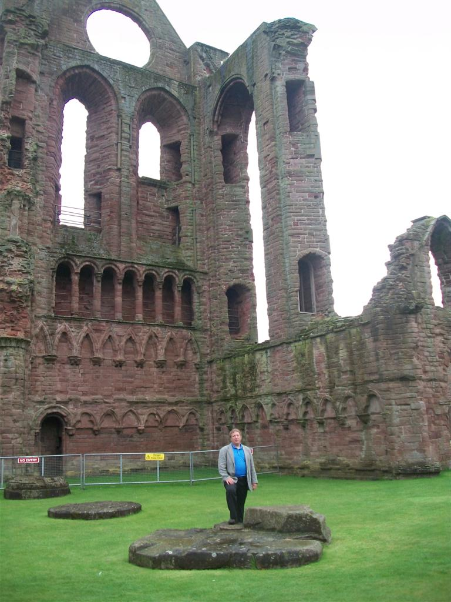
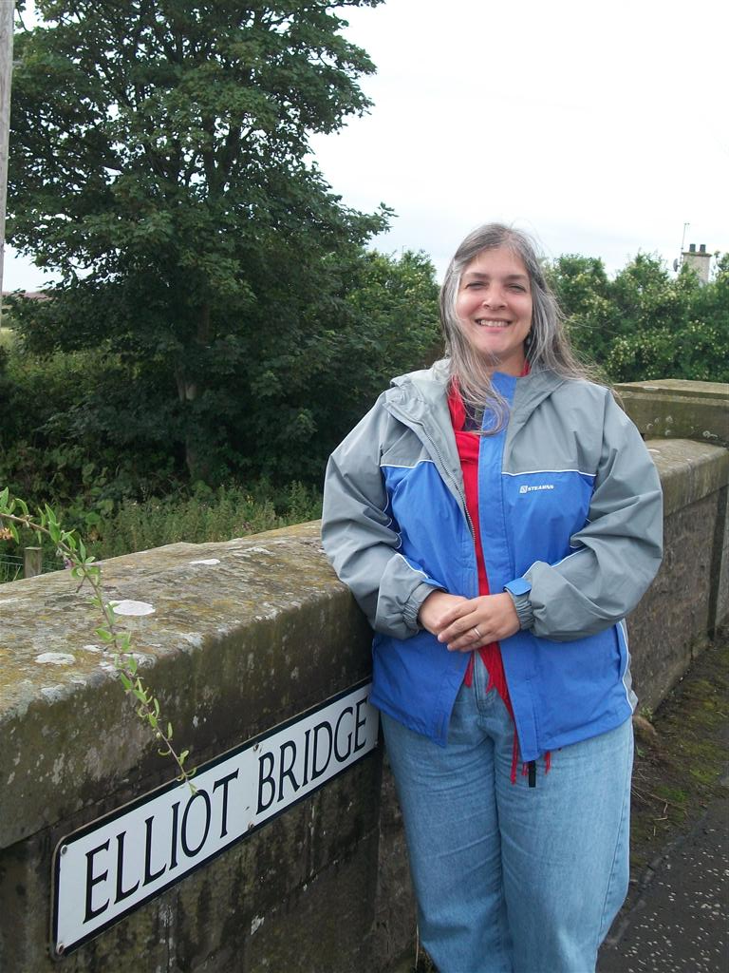
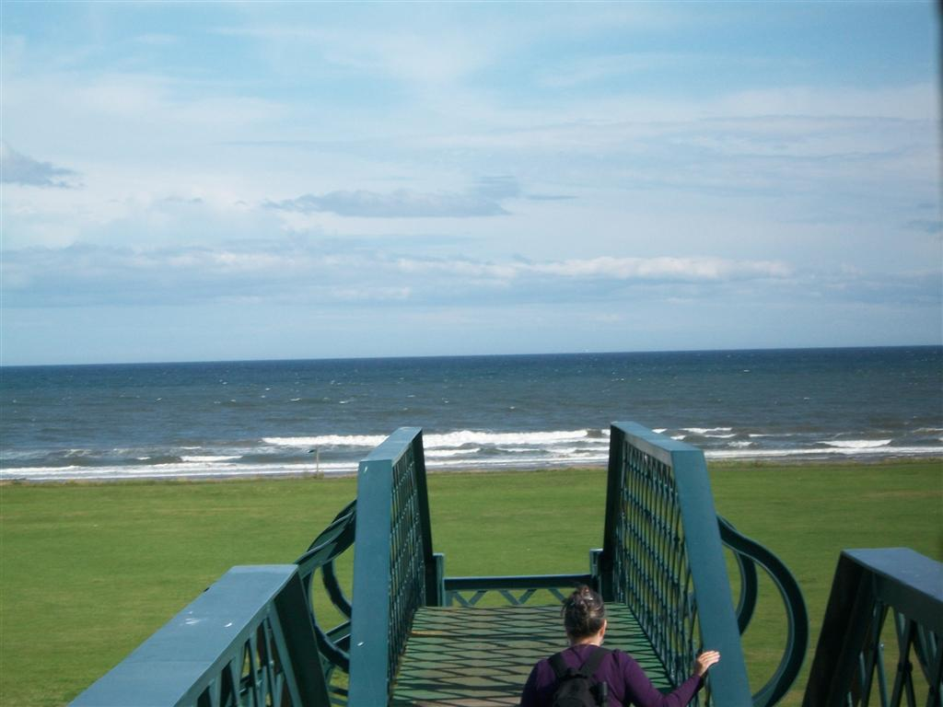
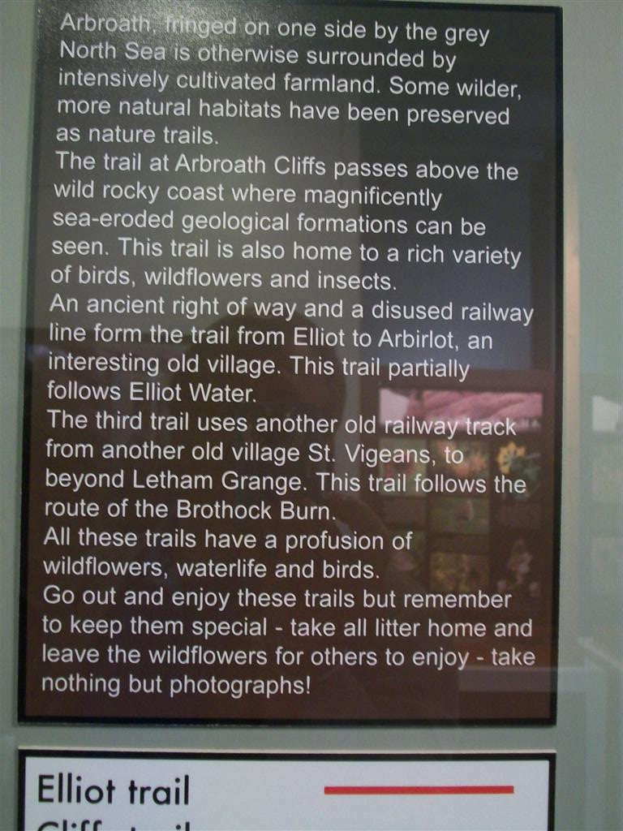
Elliots in Angus
Arbroath Abbey
The Abbey, which was the richest in Scotland, is most famous for its association with the 1320 Declaration of Scottish Independence believed to have been drafted by Abbot Bernard, who was the Chancellor of Scotland under King Robert I. (Robert the Bruce)

Slide 2
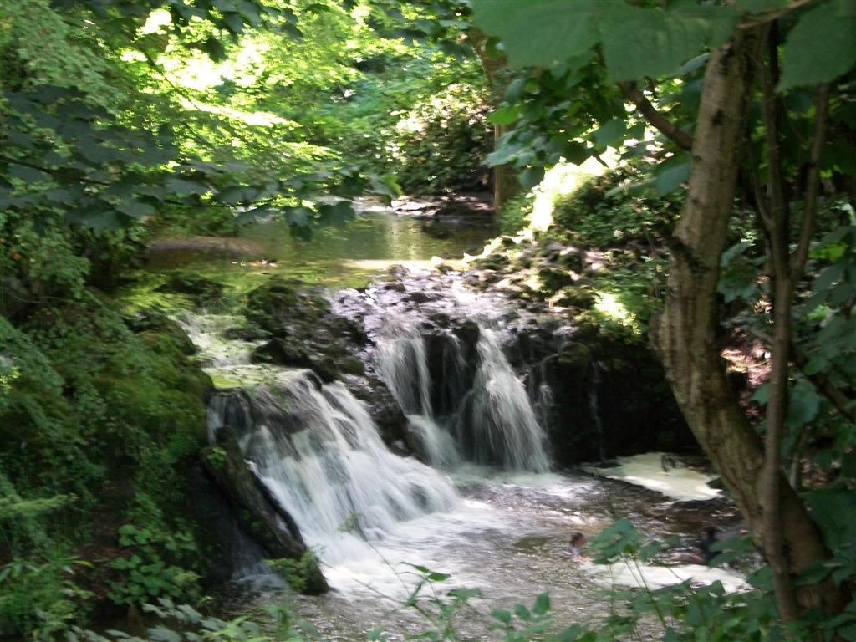
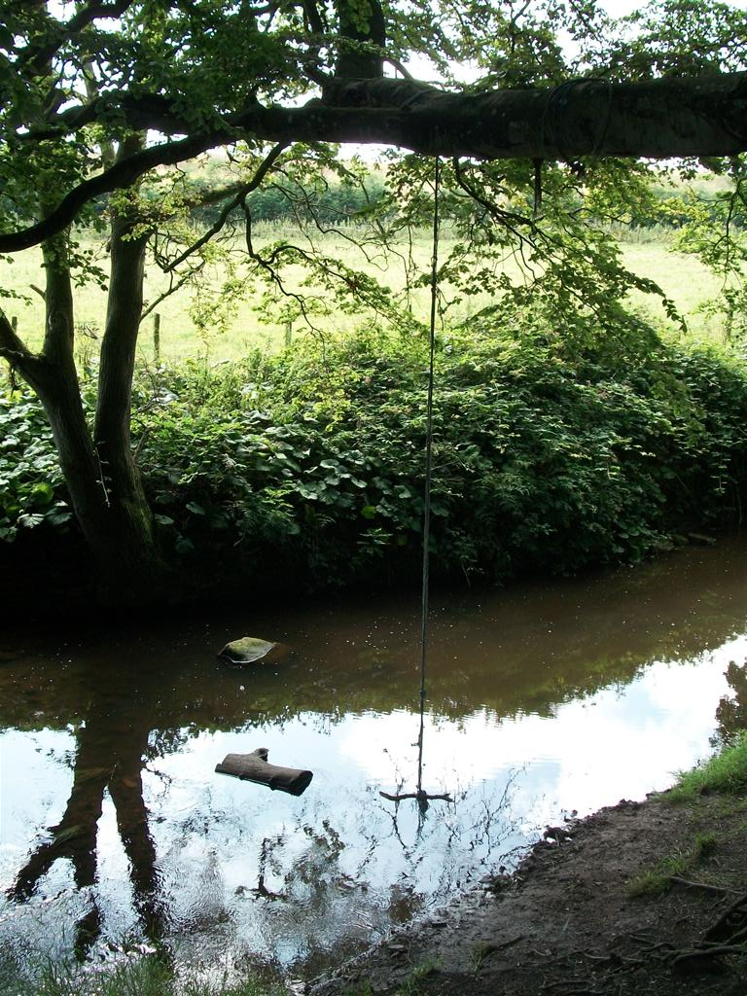
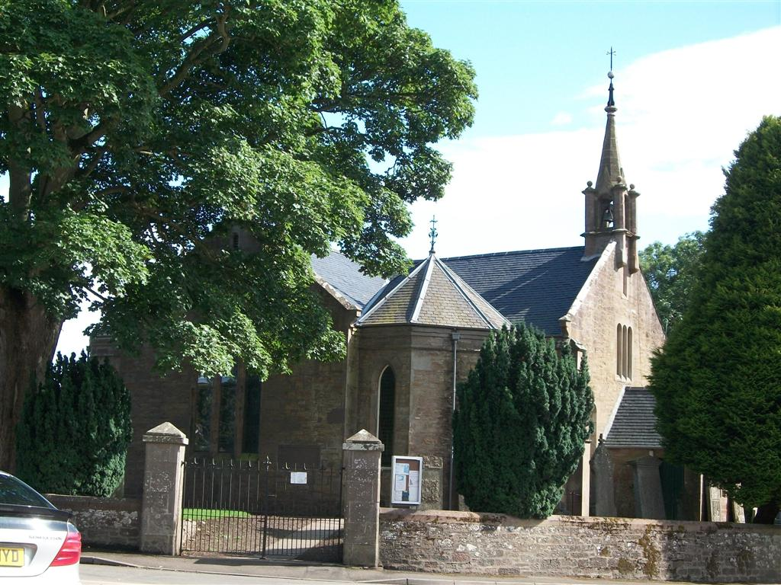
Arbirlot
Arbirlot (Gaelic: Obar Eilid) is a village in a rural parish of the same name in Angus, Scotland. The current name is usually presumed to be a contraction of Aberelliot^{[1]: 467} or Aber-Eliot ^{[2]: 147} - both meaning the mouth of the Elliot.^{[a]} It is situated west of Arbroath. The main village settlement is on the Elliot Water, 2¹⁄₂ miles (4 km) from Arbroath.

Slide 3
The Border Marches

Slide 4
Common Ridings
The Hawick Common-Riding is the first of the Border Common Ridings and celebrates both the capture of an English Flag in 1514 by the youth of Hawick at a place called Hornshole and the ancient custom of riding the marches or boundaries of the common land.

Slide 5
Hawick Reiver Festival

Slide 6
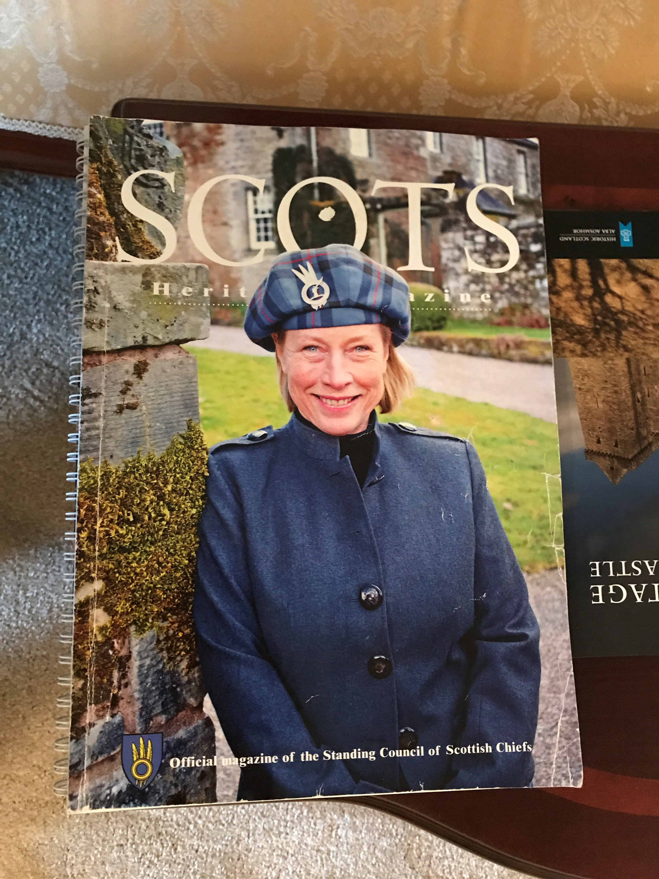
Chief Margaret Eliott

Slide 7
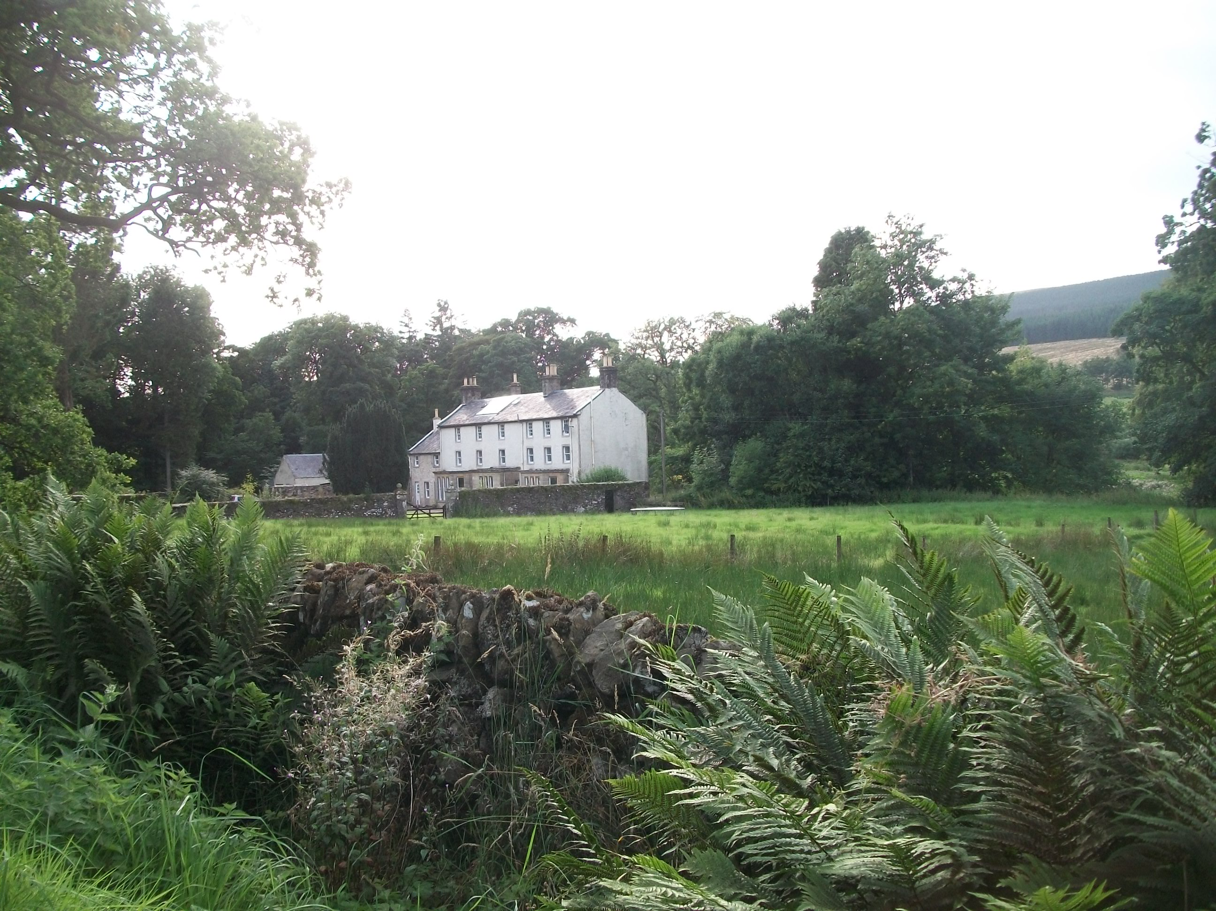
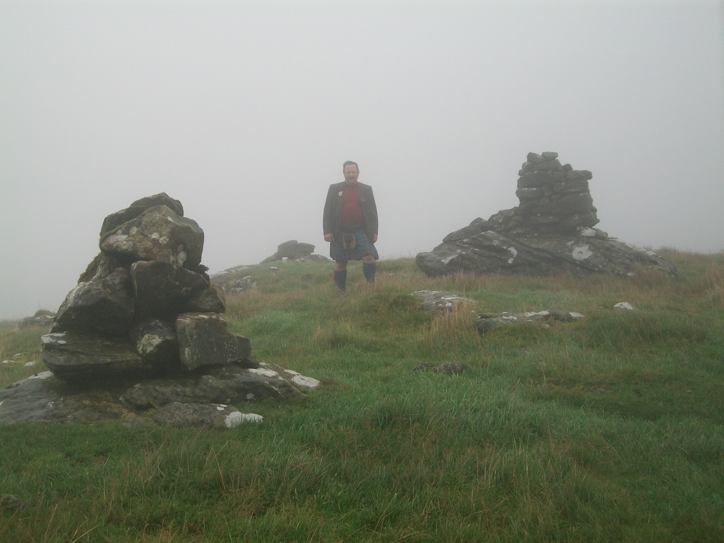
Larriston, Bloodybush Toll and the Grey Lads
George MacDonald Fraser wrote of the ‘Elliots, who dwelt in Liddesdale, and if there be a Hell, and it hath a mouth, then it gapes at the foot of that dark and terrible glen, and those within are devils incarnate.’

Slide 8
Historic Elliot Lands
Arkleton and Minto
Stobs
Redheugh and Newcastleton
Grey Lads and Bloodybush Toll across the river

Slide 9
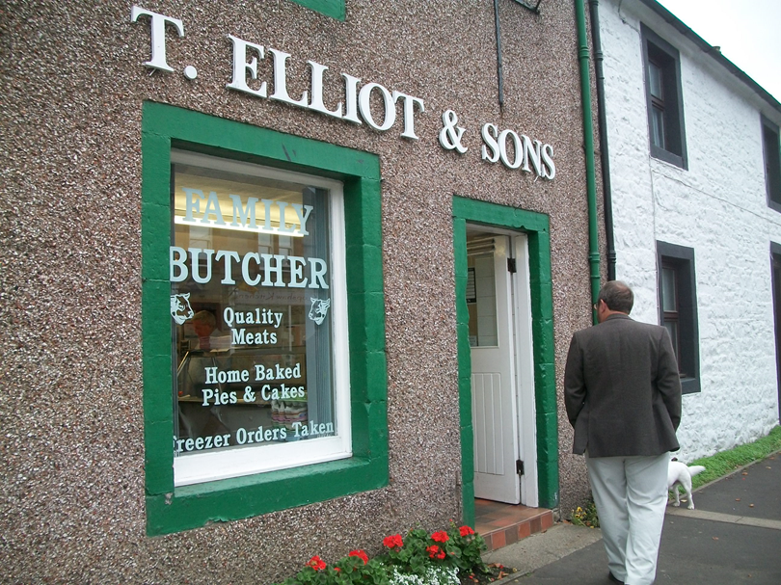
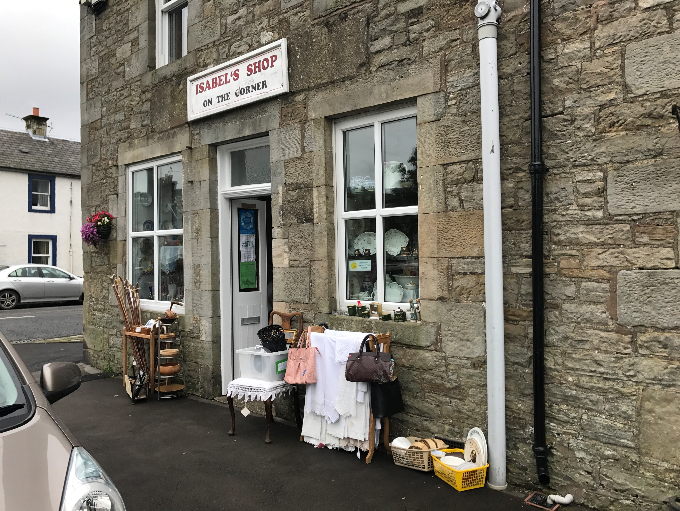
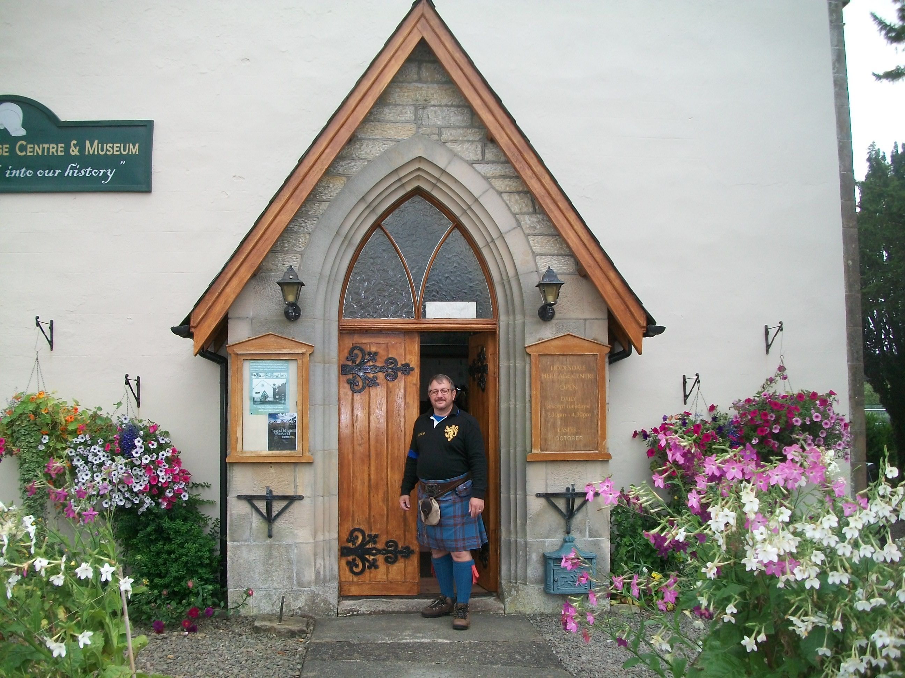
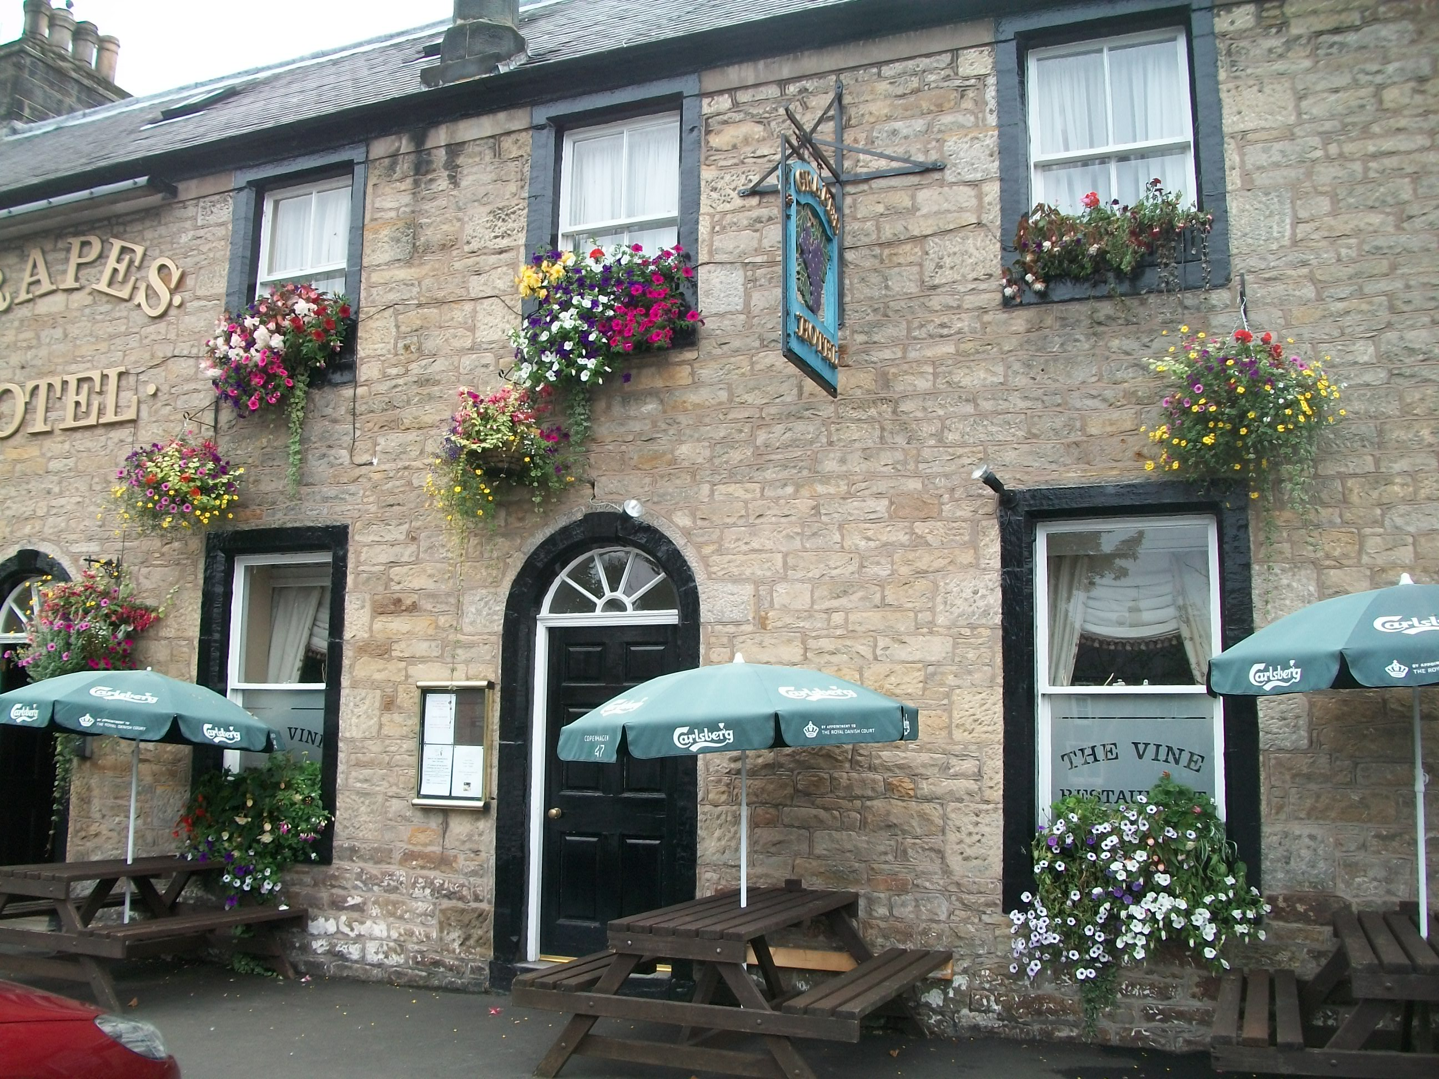
Newcastleton
And Border Reiver Museum

Slide 10
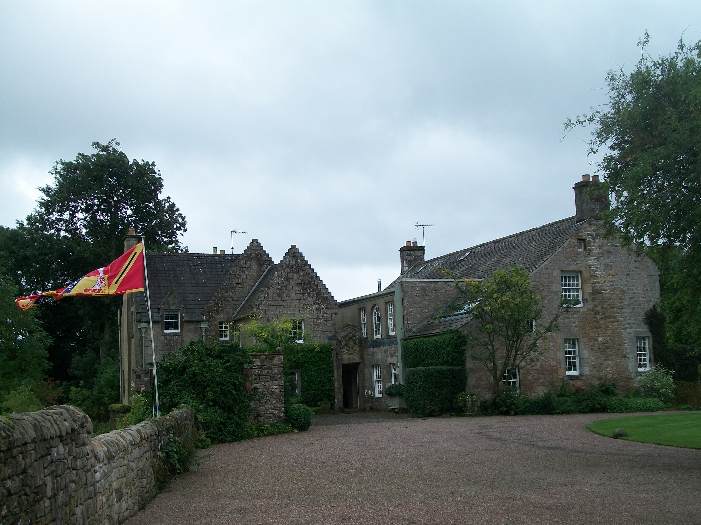
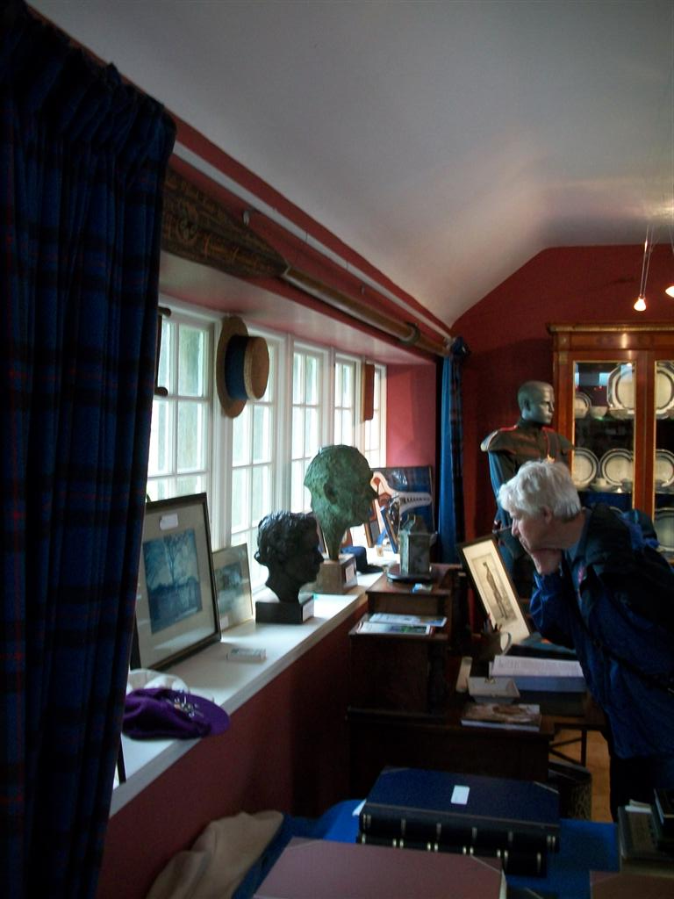
Redheugh
Not the site of the original Elliot Tower…maybe
The Clan Room
c.1320 A Charter to the lands of Redheugh was granted to a chief of the Elliots by Robert the Bruce, according to Scott of Satchels, writing in 1688.

Slide 11
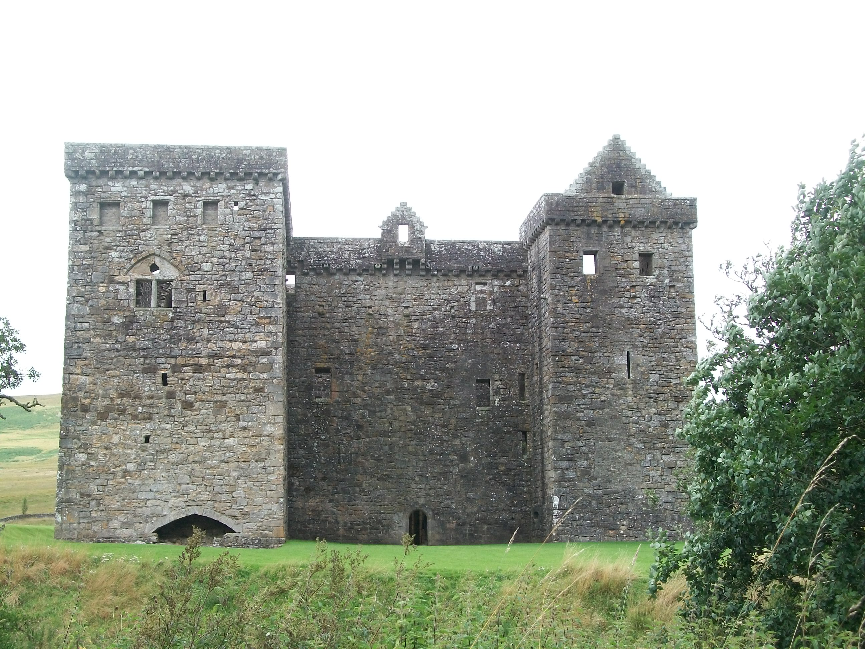
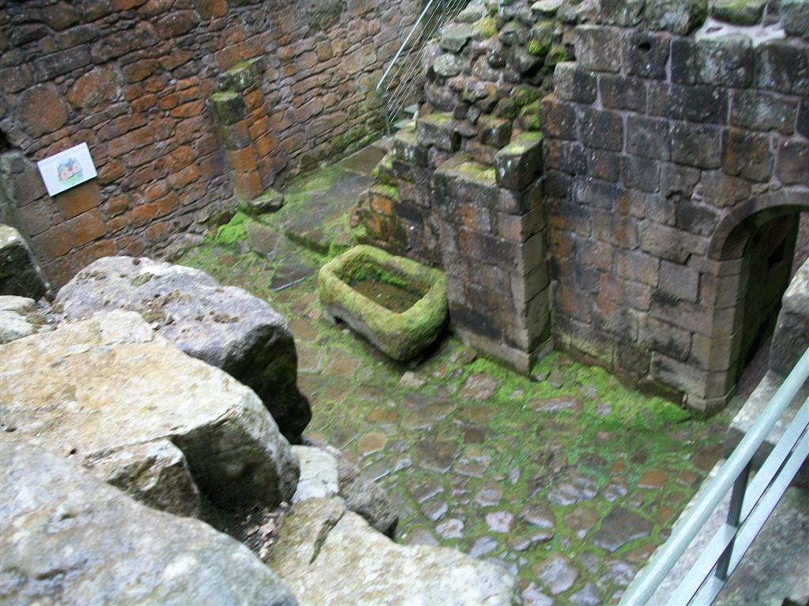
Hermitage Castle

Slide 12
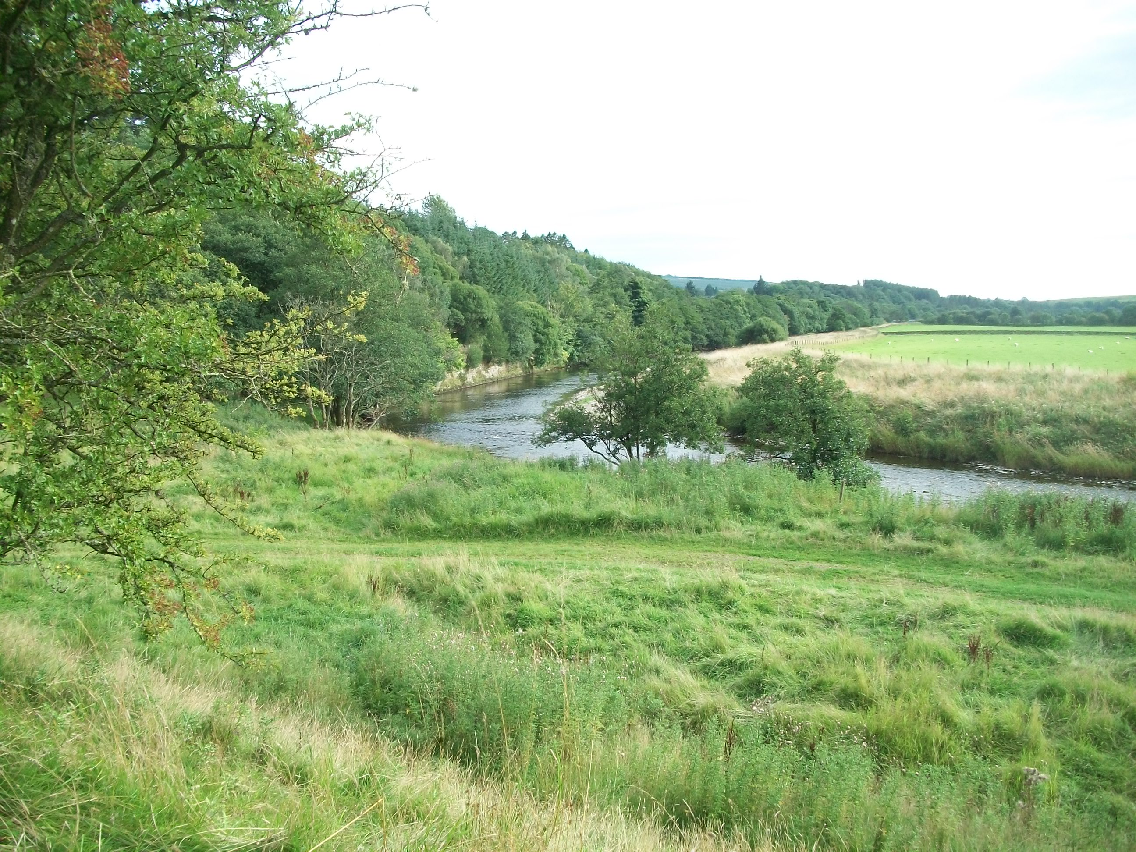
Wee Jock Elliot and Scottish Warden, Lord Bothwell

Slide 13
Little Jock Elliot
Wha daur meddle wi' me? Wha daur meddle wi' me? My name is little Jock Elliot, And wha daur meddle wi' me?
I ride on my fleet-footed grey, My sword hangind doun by my knee, My name is little Jock Elliot, And wha daur meddle wi' me?
In raids I ride always the foremost, My straik is the first in melee, My name is little Jock Elliot, And wha daur meddle wi' me?
I ne'er was afraid of a foe, Or yield I liefer wad die; My name is little Jock Elliot, And wha daur meddle wi' me?
I've vanquished the Queen's Lieutenant, And garr'd her troopers flee; My name is little Jock Elliot, And wha daur meddle wi' me?
Wha daur meddle wi' me? Wha daur meddle wi' me? My name is little Jock Elliot, And wha daur meddle wi' me?

Slide 14
Borders Railway
The Borders Railway connects the city of Edinburgh with Galashiels and Tweedbank in the Scottish Borders. The railway follows most of the alignment of the northern part of the Waverley Route, a former double-track line in southern Scotland and northern England that ran between Edinburgh and Carlisle.

Slide 15
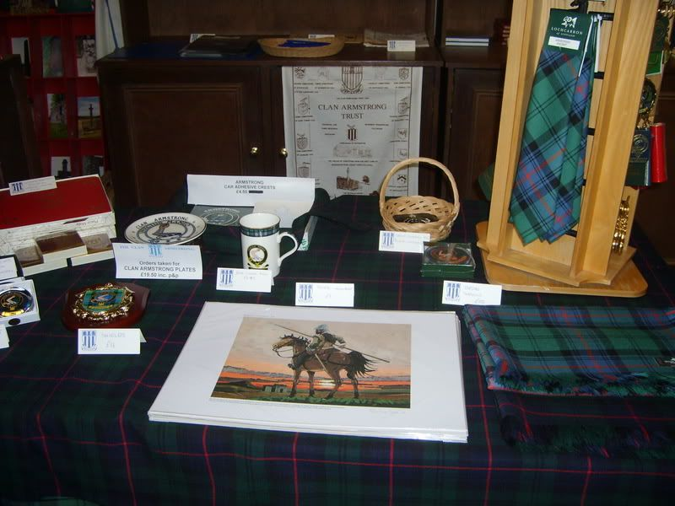
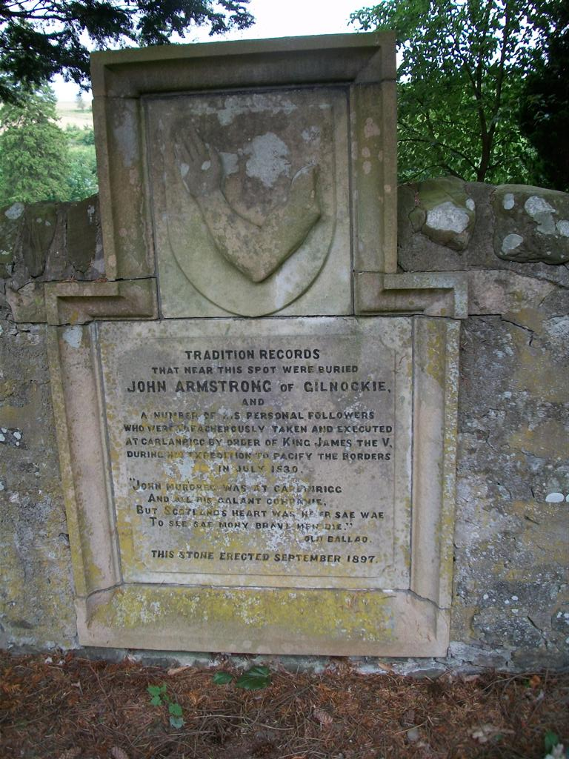
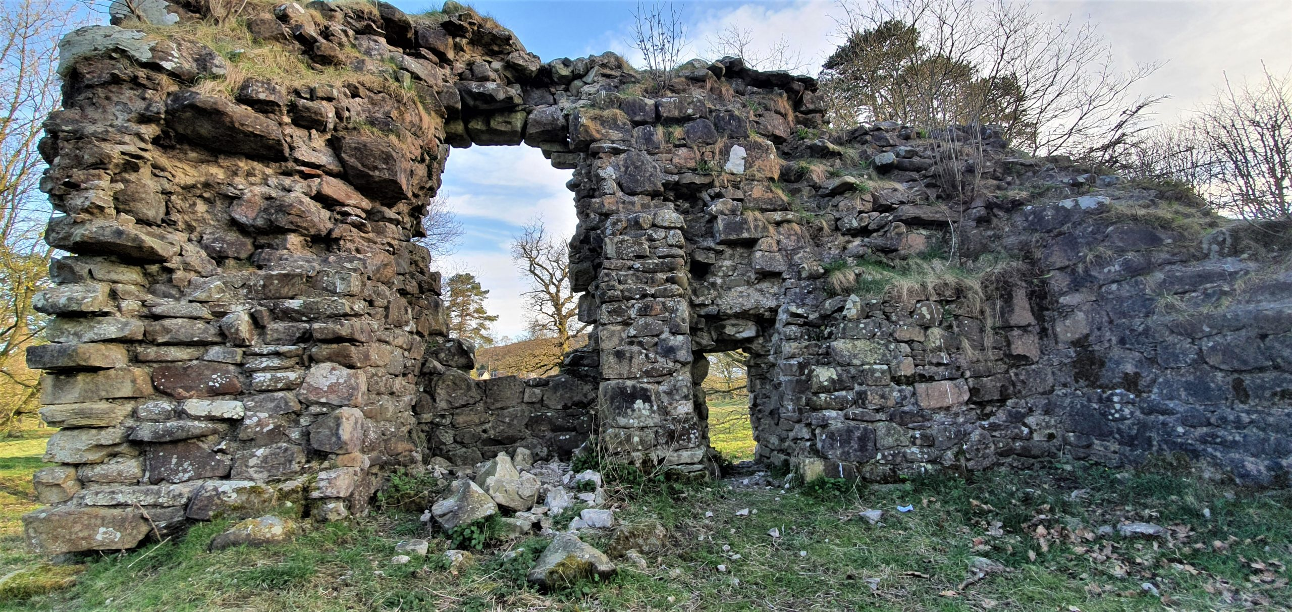
Armstrong History
Milnholm Cross
Armstrong History Center-
excellent Armstrong and Elliot genealogy info
Beautiful drive through the moors on a single track road between Newcastleton and Langholm!
Langholm Castle
Teviothead

Slide 16
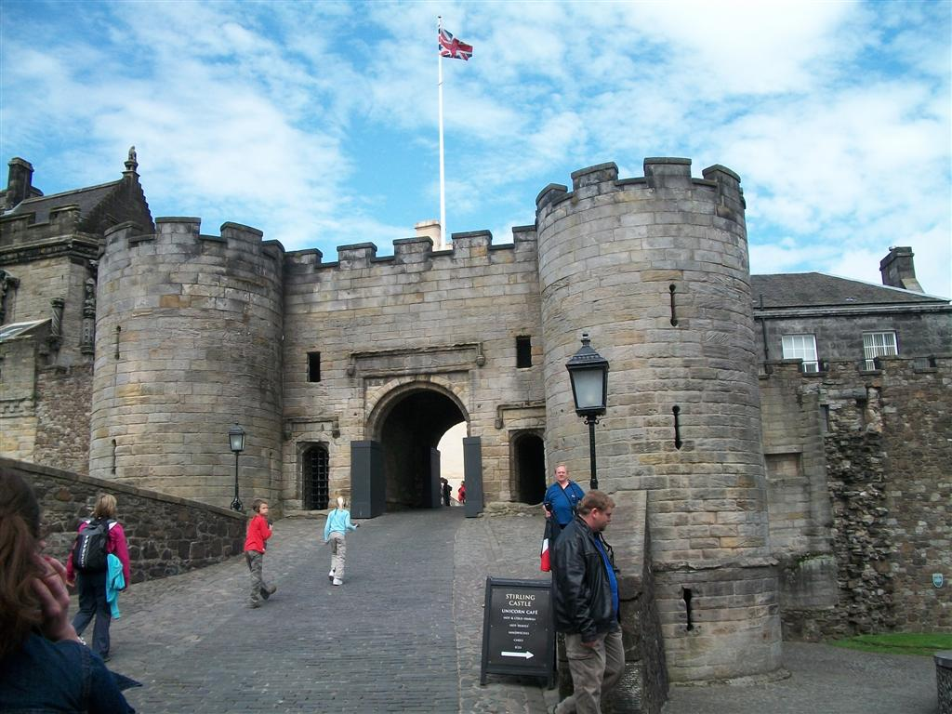
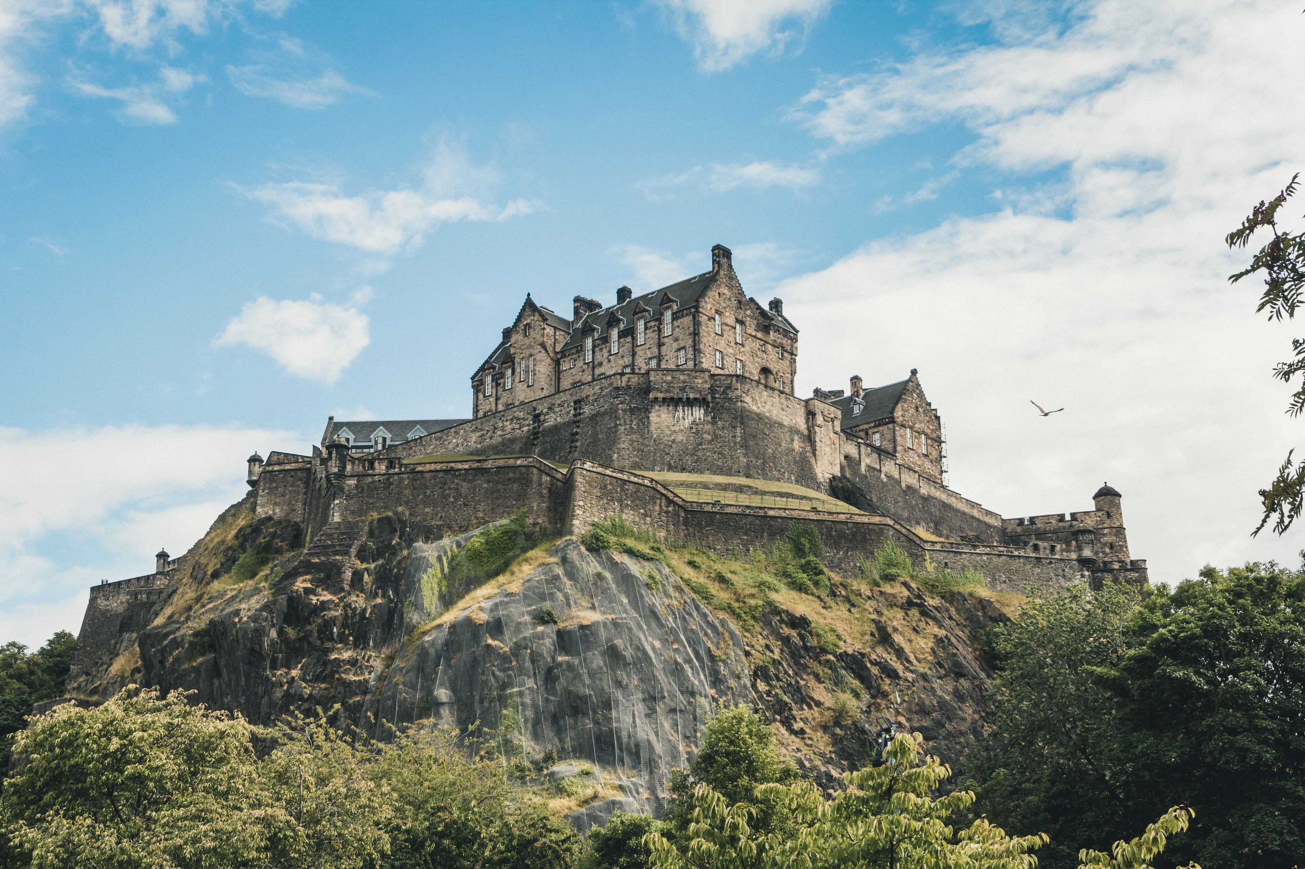
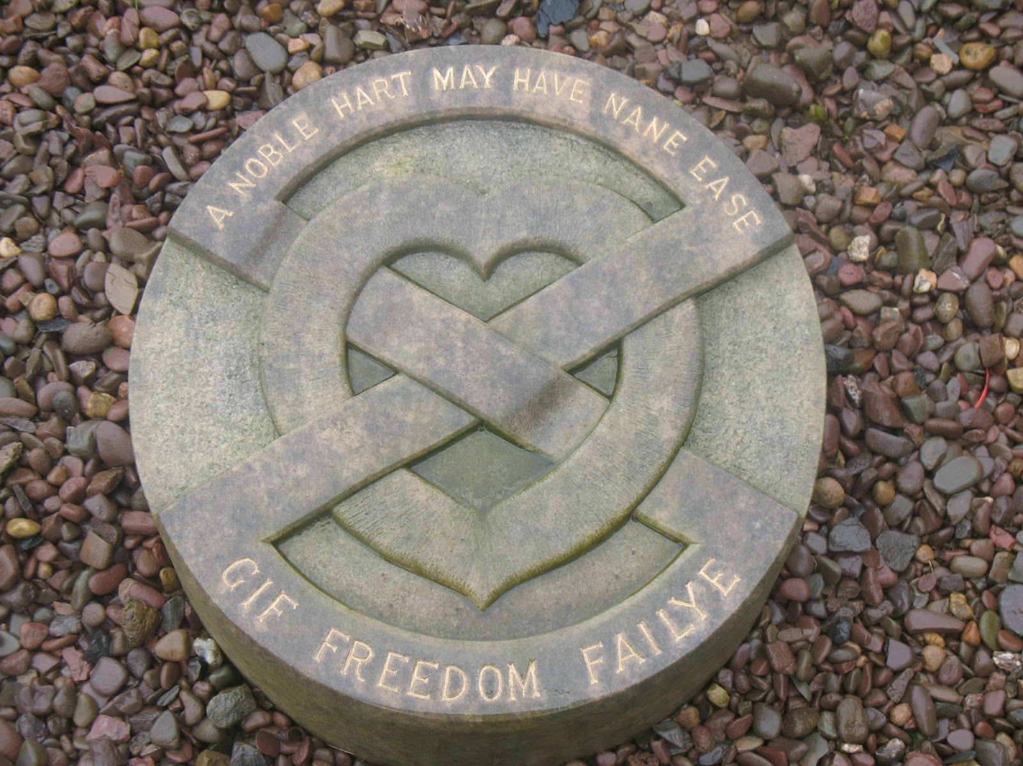
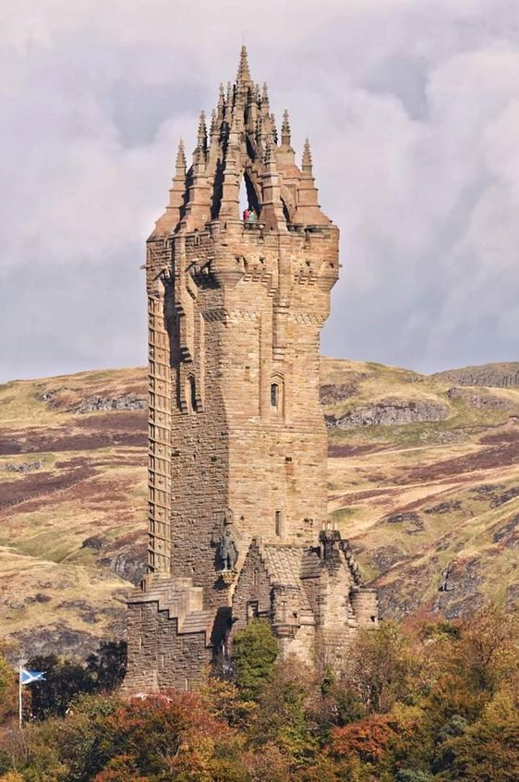
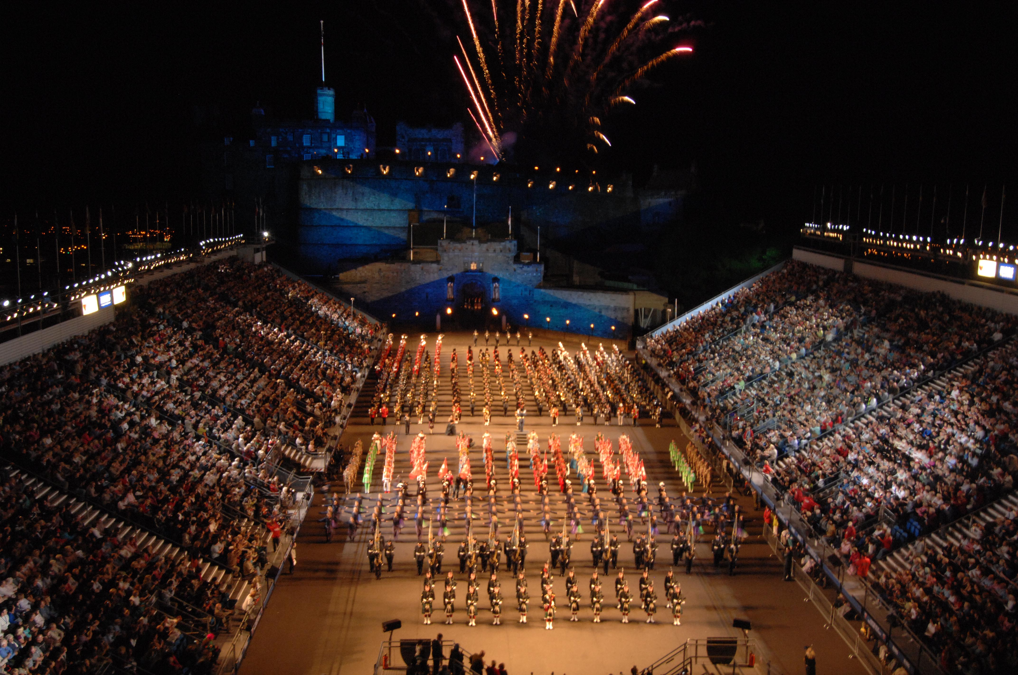
Notable Castles just a short drive from Newcastleton
Melrose Abbey
Sterling Castle
Edinburgh Castle

Slide 17
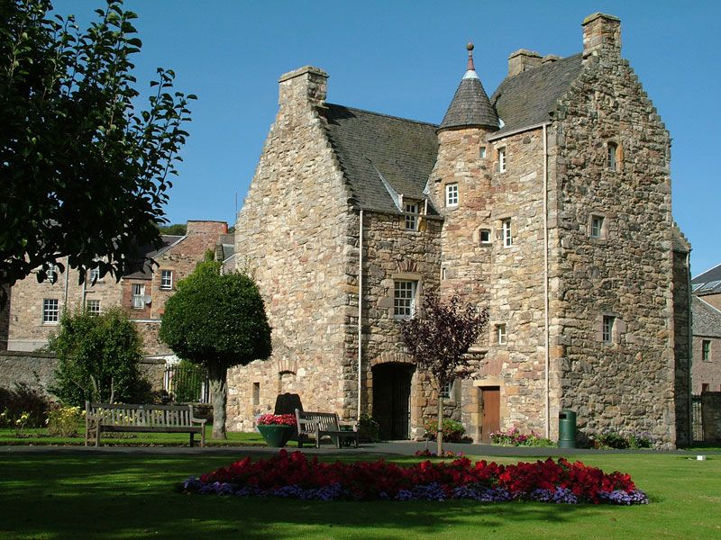
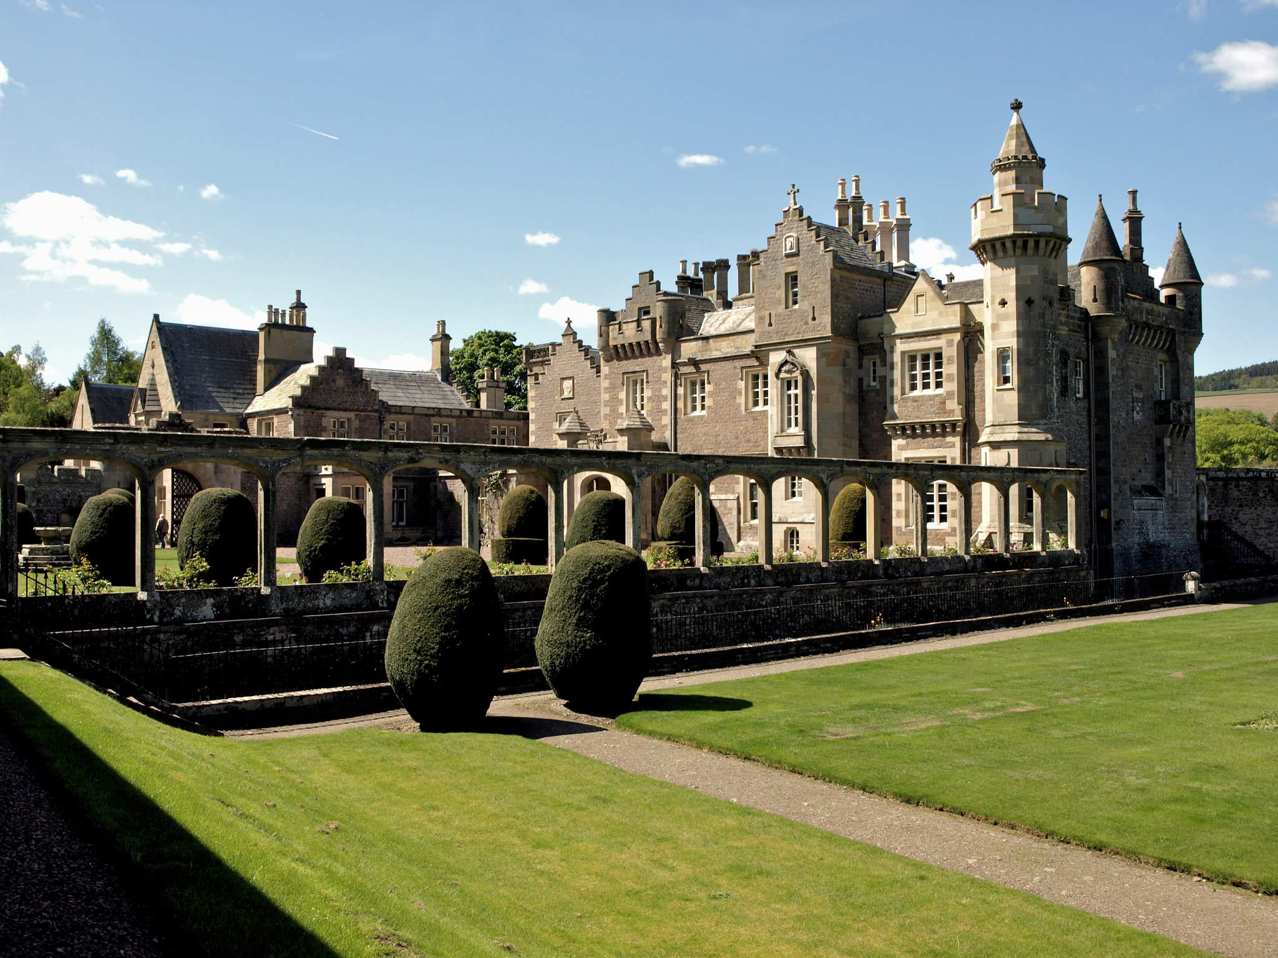
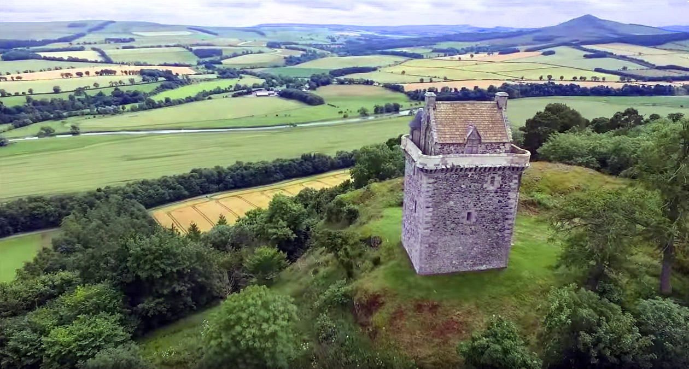
Other notable regional sites
Jedburgh Abbey
Mary Queen of Scots House
Abbotsford- Home of Sir Walter Scott
Fatlips Peel Tower

Slide 18
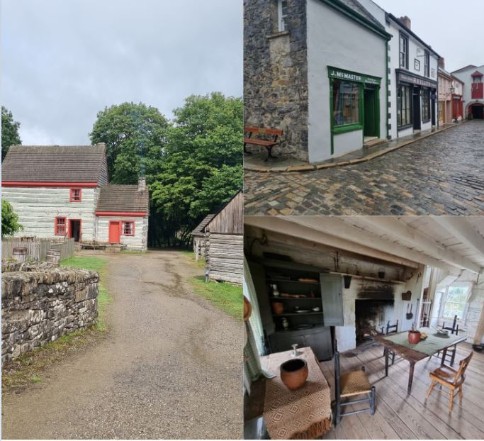
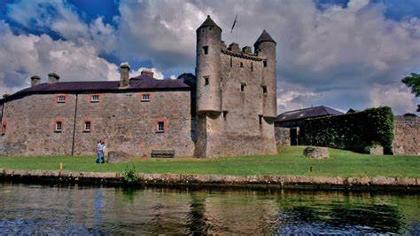
Ulster Plantation
Enniskillen Castle and Museum/ Genealogy Research Center
The Ulster American Folk Park is an open-air museum just outside Omagh, in County Tyrone, Northern Ireland. With more than 30 exhibit buildings to explore, the museum tells the story of three centuries of Irish emigration.

